Slide 1
Applications of Derivatives

Slide 2
What clues can a derivative give us about a graph?
Tell me your ideas.
How about the second derivative?

Slide 3
Global Extremes (or Absolute Extrema – plural of extremum)
Allow me to show you examples on the board of:
Absolute (global) Maximum
Absolute (global) Minimum

Slide 4
Domain Makes a Difference
Closed Interval
Can have extremes at endpoints
Open Interval
Cannot have extremes at endpoints

Slide 5
Extreme Value Theorem (KNOW)
If f is continuous on a closed interval [a,b], then f has both a maximum value and a minimum value on the interval.

Slide 6
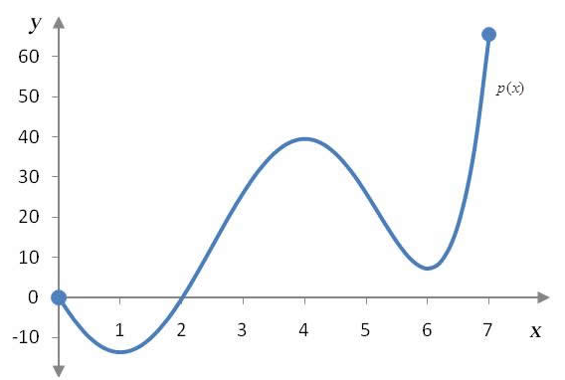
Extreme Value Theorem- Examples
Max @
Min @

Slide 7
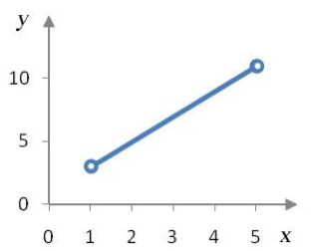
Extreme Value Theorem- Examples
Max @
Min @

Slide 8
Local (relative) Extreme Values
Local (relative) Maximum
Local (relative) Minimum

Slide 9
Questions for you!
What is the maximum?
Y-coordinate
Where is the maximum?
X-coordinate

Slide 10
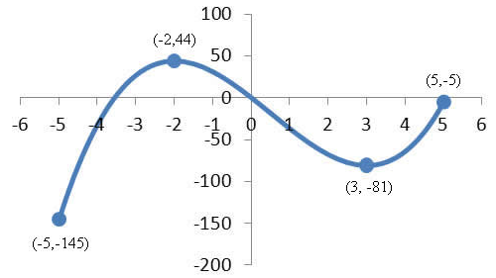
Example
What is the maximum?
44
Where is the maximum?
-2

Slide 11
Extremes Exist Where:
f’ = 0 (horizontal tangent lines)
f’ does not exist (corner, cusp, etc…)
Endpoints of an interval

Slide 12
Critical Point
A point at which f’=0 or f’ does not exist

Slide 13
Steps for finding extrema
Find derivative
Set =0 and solve
Find all zero’s (x-coordinates)
Find where derivative does note exist
Plug in x – coordinates (in order from least to greatest) into the original equation to find y-values.

Slide 14
Homework
Pg. 184
1-29, odd

Slide 15
Work Day
Pg.185
37-45, odd, 48, 49

Slide 16
Mean Value Theorem Song
If a function is continuous on a closed set a to b, and it’s also differentiable on the open set ab, you can always find a c inside such that f prime at point c, is equivalent to just the slope of the line from a to b.

Slide 17
Why hypotheses matter (pg. 186 figure 4.11)

Slide 18
What does the Mean Value Theorem mean?
The instantaneous rate of change at some interior point must equal the average rate of change on the interval.

Slide 19
Rolle’s Theorem
This was the first version of the Mean Value Theorem, proved by French mathematician Michel Rolle. In it f(a)=f(b)=0 and was proven only for polynomials. It proved that there must be a zero derivative somewhere between a and b if both of the function values are zero.

Slide 20
Rolle’s Theorem

Slide 21
Example 3, page 187
If a car accelerating from zero takes 8 seconds to go 352 feet, its average velocity for the 8-sec interval is 352/8=44 ft/sec, or 30 mph. At some point during the acceleration, the theorem says, the speedometer must read exactly 30mph. Does this stand to reason?

Slide 22
Increasing and Decreasing
Will someone please draw their idea of an increasing function and a decreasing function on the board?

Slide 23
Definitions
Let f be a function defined on an interval I and let x₁ and x₂ be any two points in I.
1. f increases on I if x₁ < x₂ → f(x₁) < f(x₂)
2. f decreases on I if x₁ < x₂ → f(x₁) > f(x₂)

Slide 24
Corollary 1: Increasing and Decreasing Functions
Let f be continuous on [a,b] and differentiable on (a,b).
1. If f’>0 at each point of (a,b), then
f increases on [a,b]
2. If f’<0 at each point of (a,b), then
f decreases on [a,b]

Slide 25
Monotonic
A function that is always increasing on an interval or always decreasing on an interval is said to be monotonic there.

Slide 26
Corollary 2: Functions with f’=0 are Constant
If f’(x)=0 at each point of an interval I, then there is a constant C for which f(x)=C for all x in I

Slide 27
Proof of Corollary 2
If f’(x)=0 for each point in the interval I: Let’s think about any two points x₁ and x_{2,} where x₁ < x₂. Since f is differentiable on [x₁,x₂], it is continuous at every point as well. Thus f satisfies the hypotheses of the Mean Value Theorem on [x₁,x₂].

Slide 28
Therefore,
There is a point c between x₁ and x₂ for which

Slide 29
Corollary 3 Functions with the Same Derivative Differ by a Constant
If f’(x)=g’(x) at each point of an interval I, then there is a constant C such that f(x)=g(x)+C for all x in I

Slide 30
Antiderivative
A function F(x) is the antiderivative of a function f(x) if F’(x)=f(x) for all x in the domain of f. The process of finding an antiderivative is antidifferentiation.

Slide 31
Assignment
Curriculum Module
192(3-24 mult 3, 35, 36 39, 42 revisit with MVT and IVT, 43, 45) omit12
(finish in class tomorrow)

Slide 32
Theorem 4 First Derivative Test for Local Extrema
I will sketch each part on the board as we go:
Think about this:
At a critical point c:
If f’ changes sign from positive to negative at c (f’>0 for x<c and f’<0 for x>c), then
f has a local maximum value at c

Slide 33
At a critical point c:
If f’ changes sign from negative to positive at c (f’<0 for x<c and f’>0 for x>c), then
f has a local minimum value at c

Slide 34
At a critical point c:
If f’ does not change sign at c (f’ has the same sign on both sides of c), then f has no local extreme value at c.

Slide 35
At a left endpoint a:
If f’<0 (f’>0) for x>a, then f has a local maximum (minimum) value at a.

Slide 36
At a right endpoint b:
If f’<0 (f’>0) for x<b, then f has a local minimum (maximum) value at b.

Slide 37
Concavity
Where have you heard of concavity before?
How do you think we will define concavity on a graph?
How do you think we can determine concavity using derivatives?

Slide 38
Definition: Concavity
The graph of a differentiable function y=f(x) is
Concave up on an open interval I if y’ is increasing on I
Concave down on an open interval I if y’ is decreasing on I
Change in y’ is what?

Slide 39
Concavity Test
The graph of a twice-differentiable function y=f(x) is
Concave up on any interval where y”>0
Concave down on any interval where y”<0

Slide 40
Point of Inflection
A point where the graph of a function has a tangent line and where the concavity changes is a point of inflection.

Slide 41
Second Derivative Test for Local Extrema
If f’(c)=0 and f”(c)<0, then f has a local maximum at x=c
If f’(c)=0 and f”(c)>0, then f has a local minimum at x=c

Slide 42
Recall (motion)
s(t) is the position function
s’(t)=v(t) is the velocity function
s”(t)=v’(t)=a(t) is the acceleration function

Slide 43
Economic Applications
Recall that marginal cost is the rate of change of cost with respect to production level.
On a cost curve, a point of inflection separates an interval of decreasing marginal cost from an interval of increasing marginal cost. (Marginal cost is the derivative/slope/rate of change of cost with change in production level)

Slide 44
Logistic Curve
Sometimes called a Life Cycle Curve
–noun Mathematics. a curve, shaped like a letter S, defined as an exponential function and used to model various forms of growth (from Dictionary.com)
Shown on page 199 fig 4.25

Slide 45
Let’s look together
At page 201 Example 8
Take note of the intervals and the sign chart
Let’s also look at page 202 diagram

Slide 46
Homework
203(1-29, odd)
Omit 11

Slide 47
Work Day
205(37,40,42-46,48)
4.1-4.3 Quiz

Slide 48
Modeling and Optimization
Model:a simplified representation of a system or phenomenon, as in the sciences or economics, with any hypotheses required to describe the system or explain the phenomenon, often mathematically.

Slide 49
Modeling and Optimization
Optimization:1. the fact of optimizing; making the best of anything. 2. the condition of being optimized. 3. Mathematics. a mathematical technique for finding a maximum or minimum value of a function of several variables subject to a set of constraints, as linear programming or systems analysis.

Slide 50
Modeling and Optimization Strategy
Understand the Problem
Read carefully
Determine what you have, what is needed, and what is irrelevant

Slide 51
Strategy step 2
Develop a Mathematical Model of the Problem
Draw pictures
Label parts important to the problem
Introduce a variable to represent the quantity to be maximized or minimized (define variable on paper)
Write a function using the variable whose extreme value gives the information sought

Slide 52
Strategy step 3
Graph the function
Examine the domain
Determine what values of the variable make sense

Slide 53
Strategy step 4
Identify the Critical Points and Endpoints
Find where the derivative is zero
Find where the derivative fails to exist

Slide 54
Strategy step 5 & 6
Solve the Mathematical Model
If possible, support or confirm your results with another method
Interpret the Solution
Translate your mathematical result into the problem setting (give it units or context)
Decide if the result makes sense

Slide 55
Applications: Marginal Analysis
Because differentiable functions are locally linear, we can use the marginals to approximate the extra revenue, cost, or profit resulting from selling or producing one more item. Using these approximations is referred to as marginal analysis

Slide 56
Maximum Profit
Maximum profit (if any) occurs at a production level at which marginal revenue equals marginal cost. (This has an easy/interesting proof on page 211)

Slide 57
Minimizing Average cost
The production level (if any) at which average cost is smallest is a level at which the average cost equals the marginal cost. (Let’s see this proof p.212)

Slide 58
Note to self: We had better work on some of these together! ☺
Homework:
214(1,5,8,9,12,17)

Slide 59
Work Day
215(19, 20, 26, 31, 35)

Slide 60
Work Day
217(36,38,40,41)

Slide 61
Brief Review: Linearization
Recall: a linearization just used the point-slope equation of a line y-y₁=m(x-x₁) in the form L(x)=f(a)+f’(a)(x-a) where the x=a₁

Slide 62
Homework
229(5, 6, 8, 14)

Slide 63
Related Rates
Any equation involving two or more variables that are differentiable functions of time can be used to find an equation that relates their corresponding rates.
Can you think of any examples of this?

Slide 64
Problem Solving Strategy Step 1
Draw picture and name the variables and constants
Use t for time
Assume that all variables are differentiable functions of t

Slide 65
Step 2
Write down the numerical information
In terms of symbols you have chosen

Slide 66
Step 3
Write down what you are asked to find
Usually rate expressed as a derivative

Slide 67
Step 4
Write an equation that relates the variables
You may have to combine two or more equations to get a single equation that relates the variable whose rate you want to the variables whose rates you know.

Slide 68
Step 5
Differentiate with respect to t
Then express the rate you want in terms of the rate and variables whose values you know

Slide 69
Step 6
Evaluate
Use known values to find the unknown rate.

Slide 70
Homework
237 (3,6,9,12,13,15)

Slide 71
Work Day
238(18, 21, 22, 24, 27)

Slide 72
Work Day
239(30, 33, 36)

Slide 73
Work Day
242(23, 32, 35-39, 56, 58, 67)

